Slide 1

DevOps Pipeline for Instagram Reach Prediction
A comprehensive CI/CD implementation showcasing modern DevOps practices
Ansh Sehgal 22070122021
Aryan Bhoi 22070122033
Shrishti Bajpai 22070122205
Shubham Upadhyay 22070122209

Slide 2







Project Overview
End-to-end automated pipeline for ML-based Instagram reach prediction
Python & Flask
Docker
Kubernetes
Ansible
Prometheus
Grafana
GitHub Actions

Slide 3
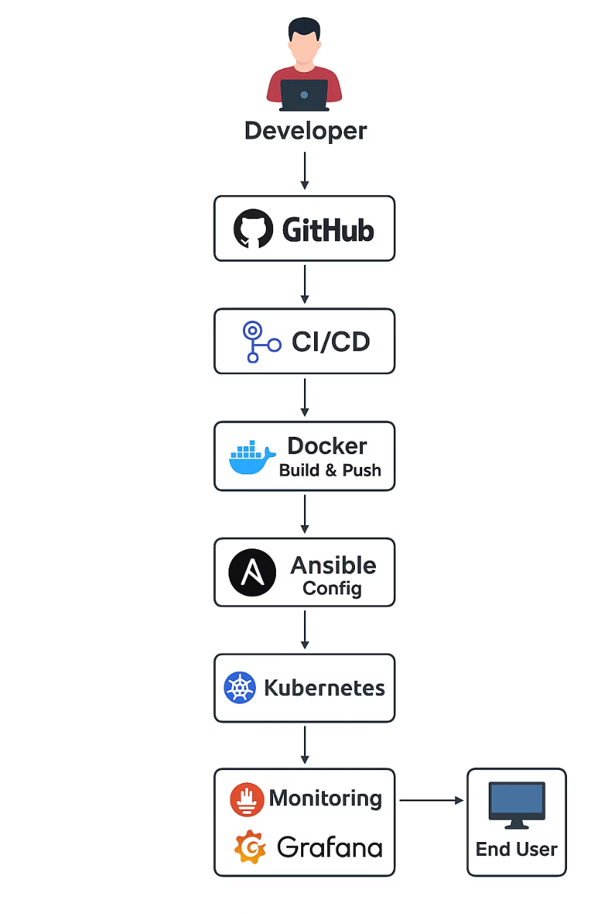
Architecture Diagram
End-to-end pipeline: code → CI/CD → containerisation → orchestration → monitoring

Slide 4
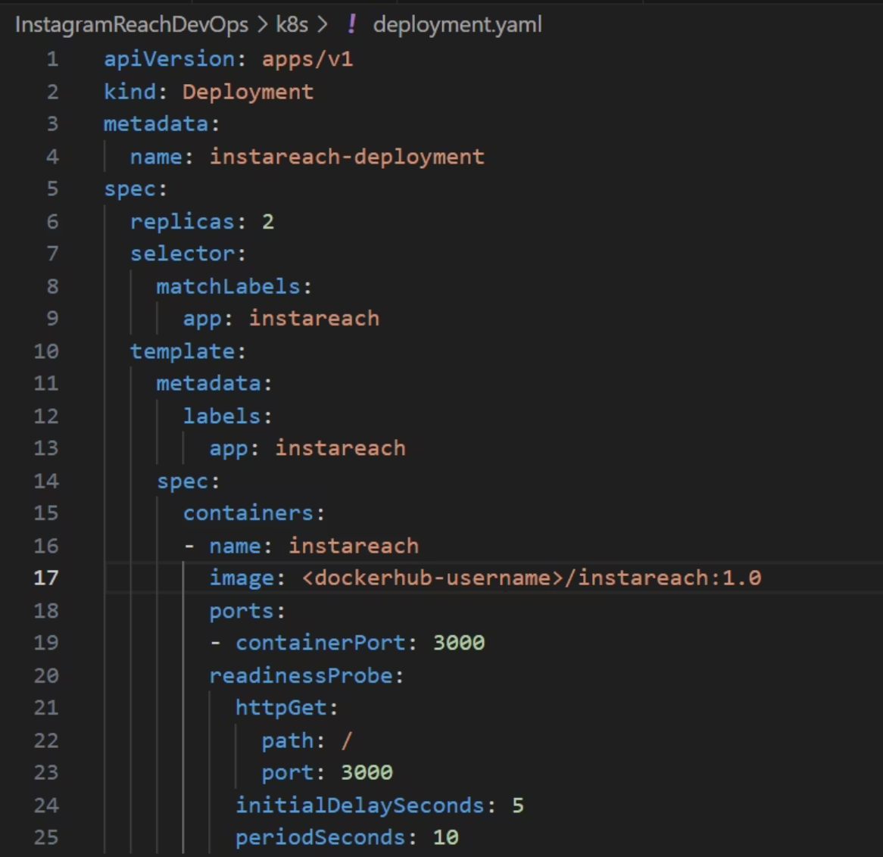
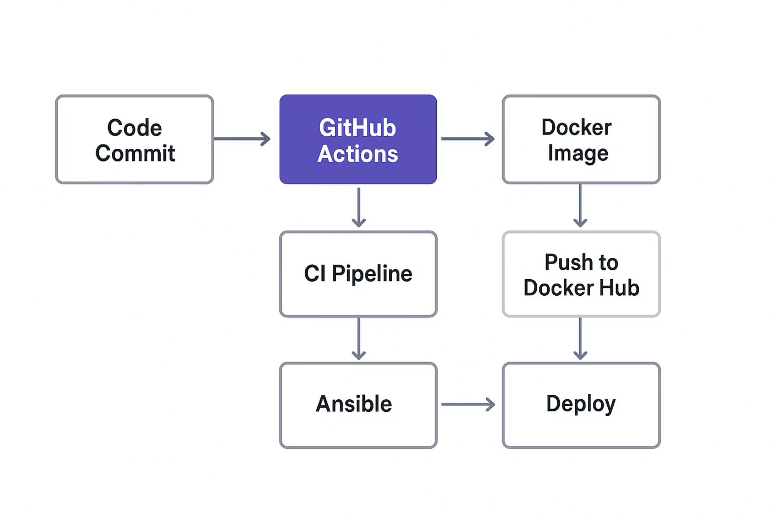
Deployment Strategy
GitHub Actions powers the automated build and deployment pipeline
Workflow Configuration
Pipeline Execution

Slide 5
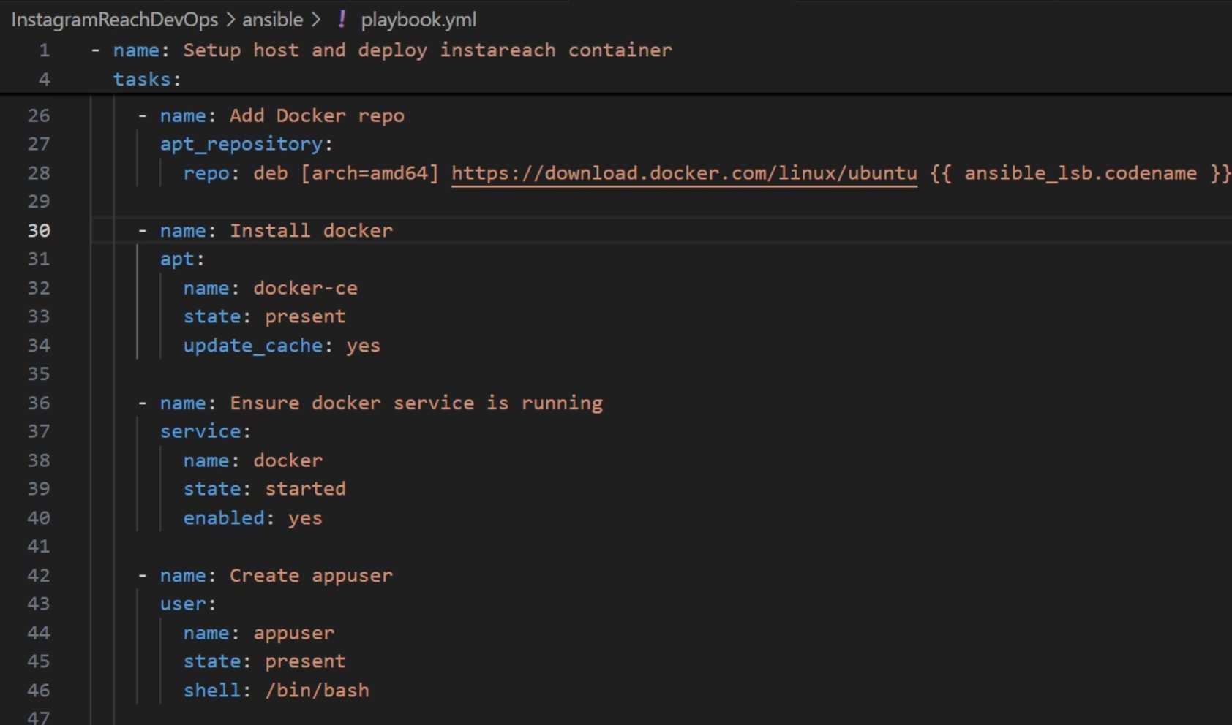
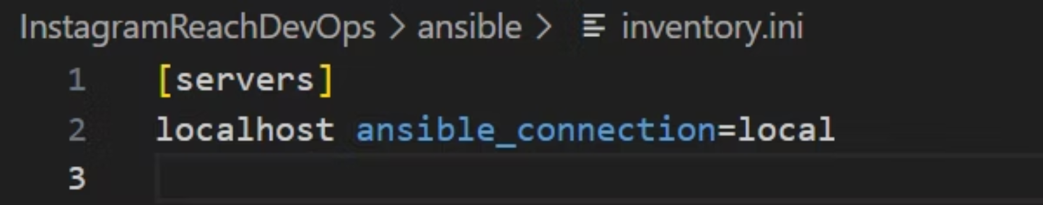
Configuration Management (IaC)
Ansible automates environment setup and configuration
Package Installation
Environment Setup
Config Management
Automated dependency management
Consistent configuration across environments
Version-controlled infrastructure

Slide 6



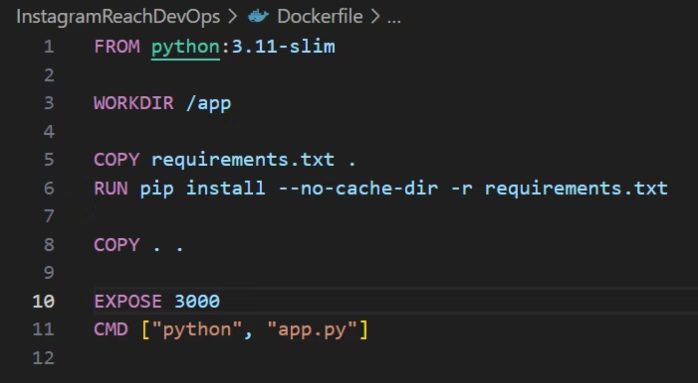
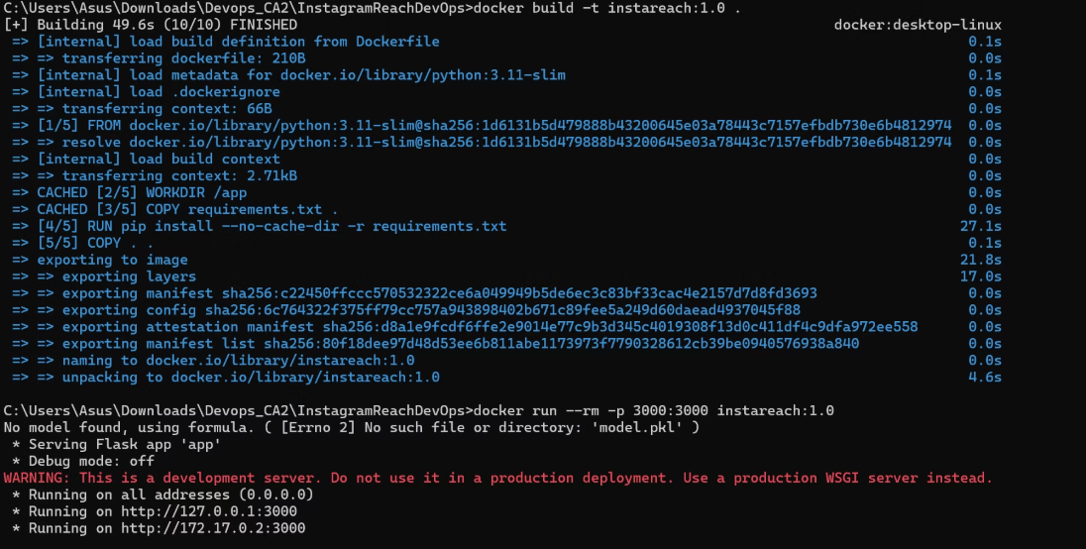
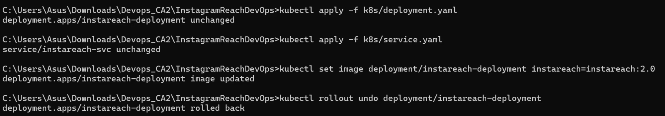
Containerisation & Orchestration
Dockerised Flask App
Kubernetes Deployment
Rolling Updates
Portable container image
Scalable orchestration
Zero-downtime deployments

Slide 7
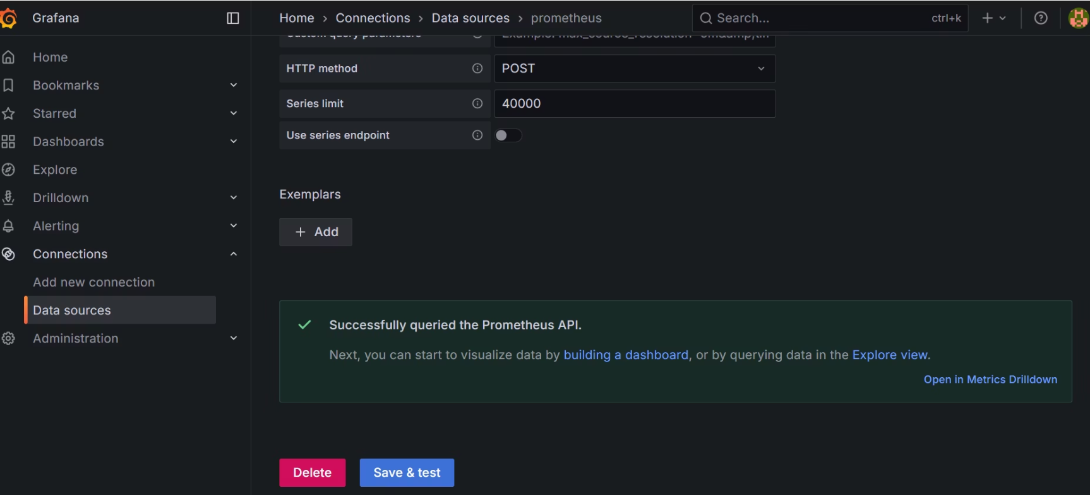
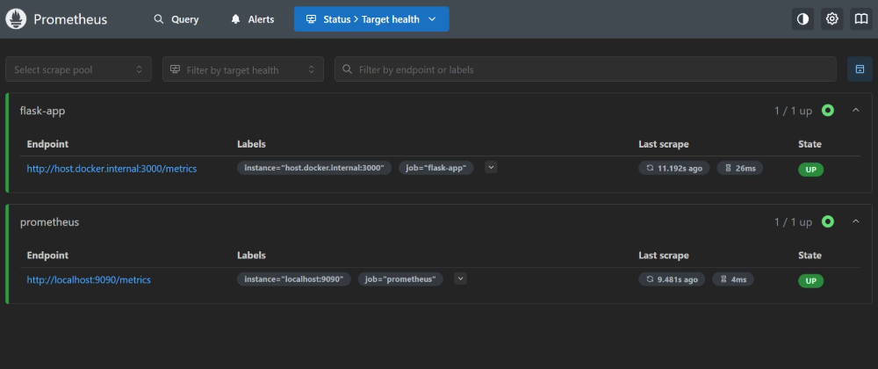
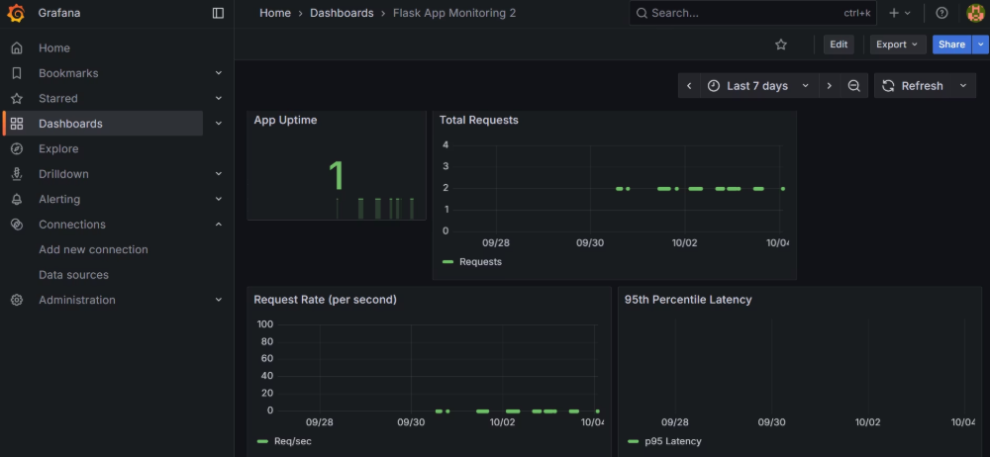
Monitoring & Logging
Real-time metrics collection and visualisation
01
02
03
Flask /metrics Endpoint
Prometheus Scraping
Grafana Dashboard
Custom metrics exposed
Time-series data collection
Latency, requests, uptime tracking

Slide 8







Pipeline Flow
Integrated DevOps workflow connecting all components
Code
CI/CD
Docker
K8s
Prometheus
Grafana

Slide 9
Challenges Faced
YAML Debugging
Docker Networking
Grafana Metrics
Syntax errors in GitHub Actions workflows required careful validation
Connecting Prometheus to containerised Flask app across networks
Dashboard initially failed to display metrics due to data source configuration

Slide 10



Lessons Learnt
CI/CD Integration
Infrastructure as Code
Observability
Mastered GitHub Actions for automated testing, building, and deployment workflows
Hands-on experience with Ansible playbooks and Kubernetes manifest management
Learnt to expose custom application metrics for comprehensive monitoring

